Slide 1
Chromosomes

Slide 2
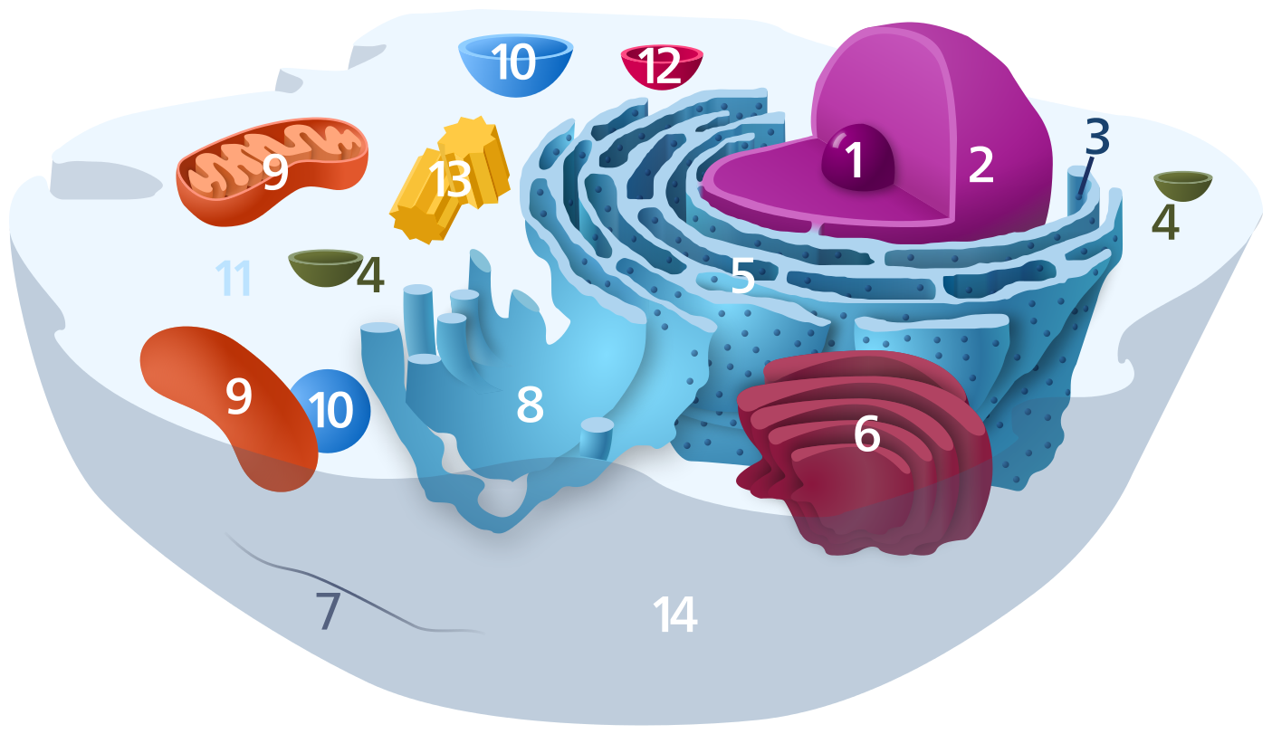
Name some parts of the cell

Slide 3
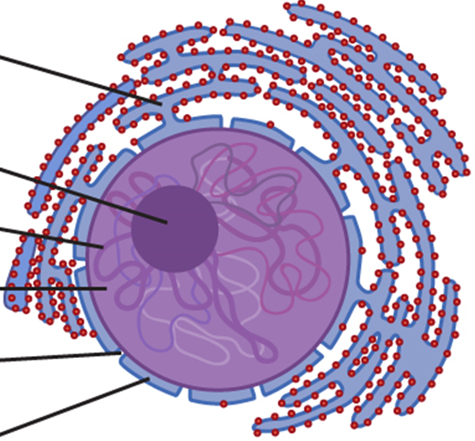
What is inside the nucleus?

Slide 4
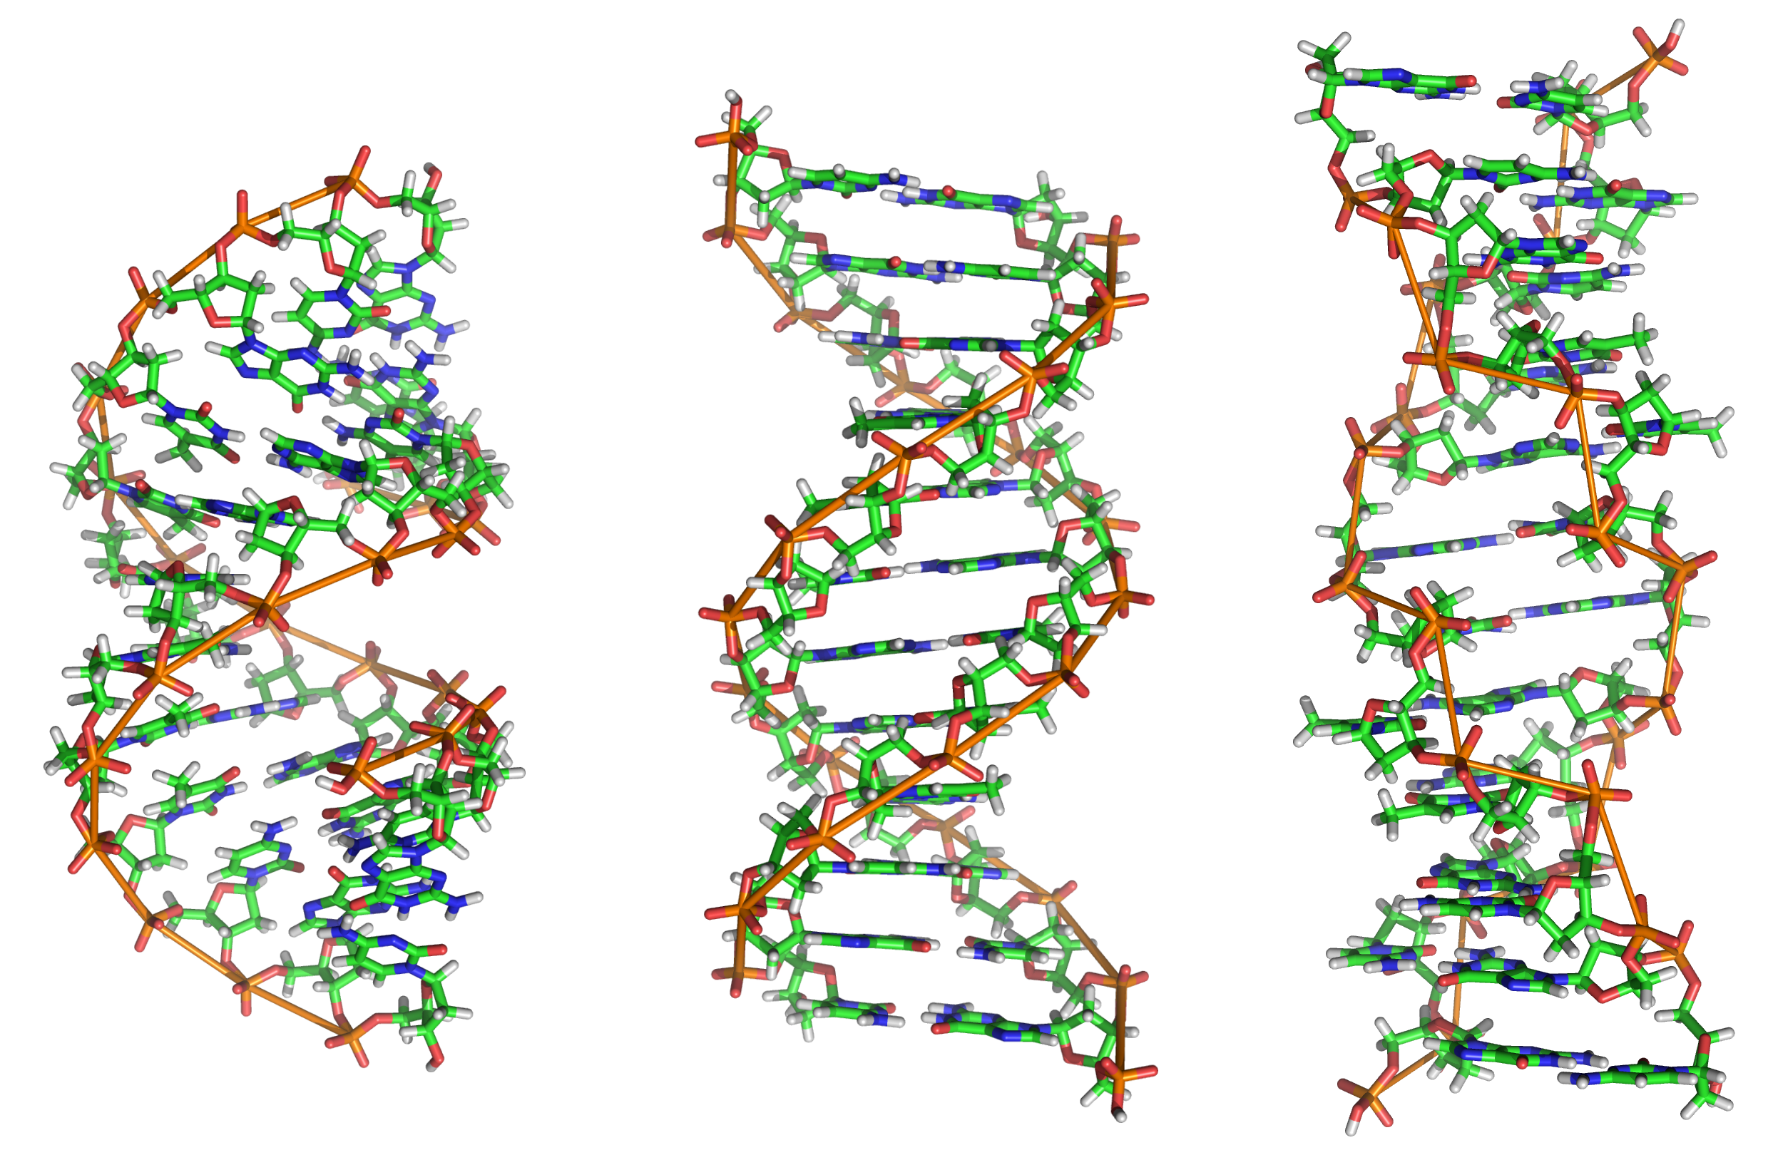
Where in the nucleus is DNA found?

Slide 5
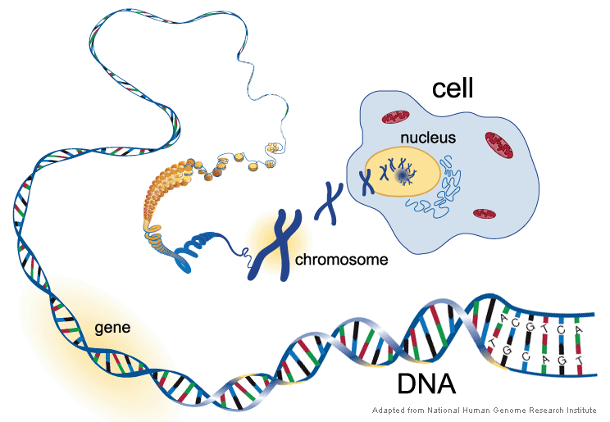

Slide 6
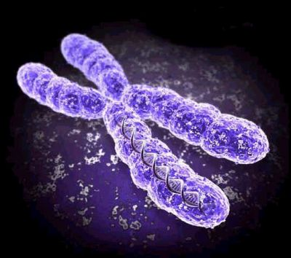
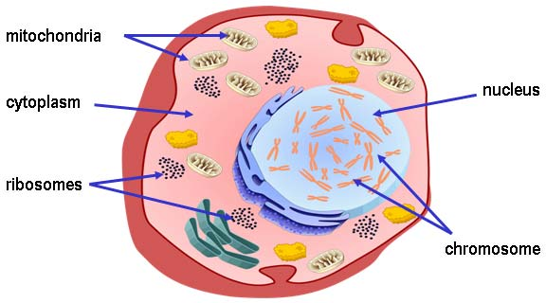
Chromosomes
Condensed DNA coiled around proteins
Chromosomes appear when the cell is ready to divide

Slide 7
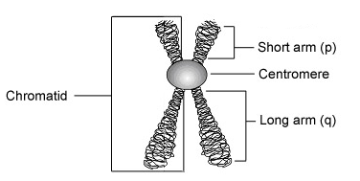
Chromosome structure
Centromere- holds the chromatids together
Chromatid: The two halves of a chromosome (sister chromatids)

Slide 8
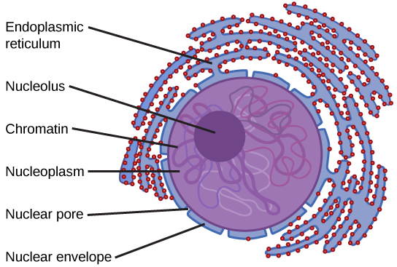
Chromatin
Uncoiled DNA

Slide 9
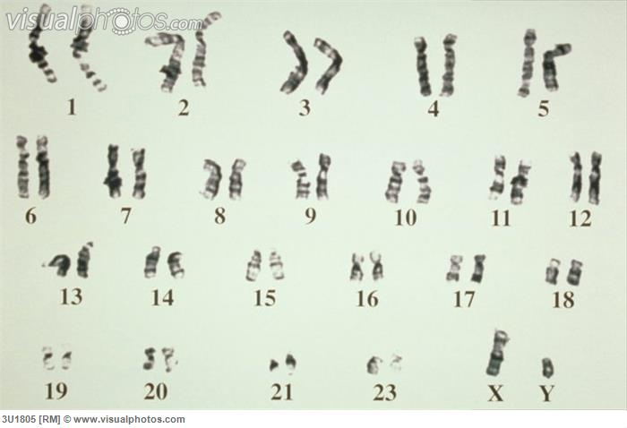
Chromosomes in humans
Humans have 46 chromosomes (or 23 pairs)
One comes from our mom and the other from our dad
Karyotype: A picture of our chromosomes

Slide 10
Difference between men and women
Sex chromosomes: determine the sex of a person
XY= boy
XX= girl

