Slide 1
Experiment 1 http://www.education.com/science-fair/article/disappearing-beaker/
Experiment 2 http://io9.com/5868524/make-a-penny-disappear-with-water-as-long-as-its-dry
Experiment 3

Slide 2
Lab- Recap

Slide 3
Vocabulary
Reflection
Refraction
Index of refraction
Total internal reflection

Slide 4
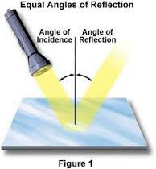
Reflection
When light bounces off a surface

Slide 5
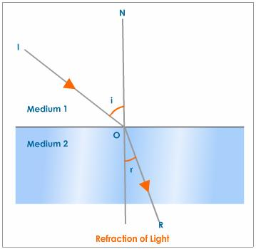
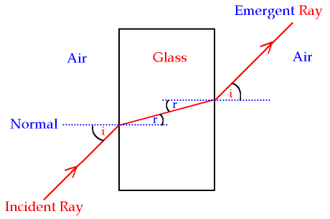
Refraction
When light bends due to a change in speed

Slide 6
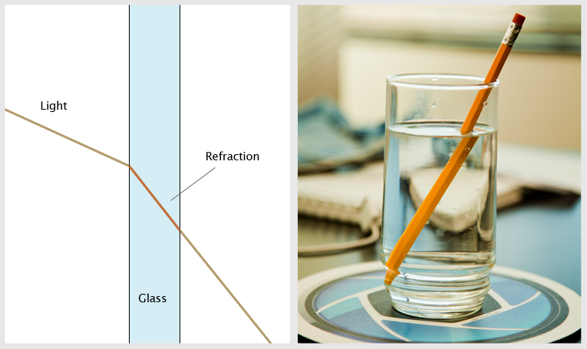
Index of refraction
A material´s index of refraction is a measure of how fast light moves through it
Light only moves at light speed through a vacuum. Anywhere else it is effectively slowed down

Slide 7
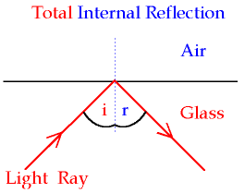
Total internal reflection
When all light undergoes reflection
Occurs only if the following are met:
a) The angle of incidence is greater than the critical angle (angle at which the light is no longer refracted)
b) The ray is passing from a denser medium to a less dense medium

Slide 8
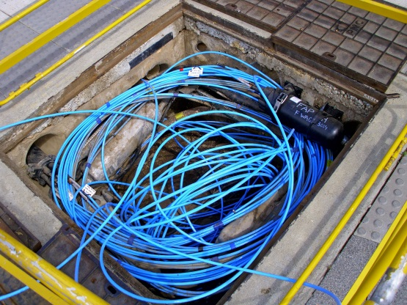
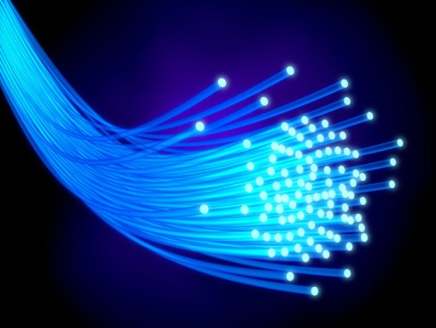
Total internal reflection and optical fibers
Optical fibers are flexible, transparent materials made of glass or plastic. They are slightly thicker than hair
They function as “pipes” to transmit light or electric currents
Uses: telephone system, cable TV system, internet and computer networking

Slide 9
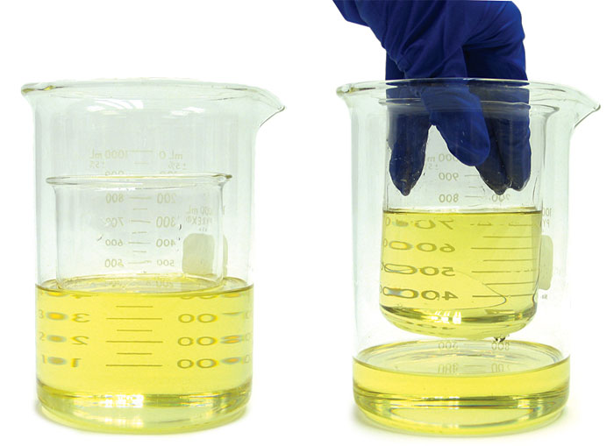
Experiment 1
Why does it work?
Objects are visible if light is reflected or refracted. If neither occurs, then, objects disappear. In this case, light is neither reflected nor refracted because the oil and the glass have the same index of refraction

Slide 10
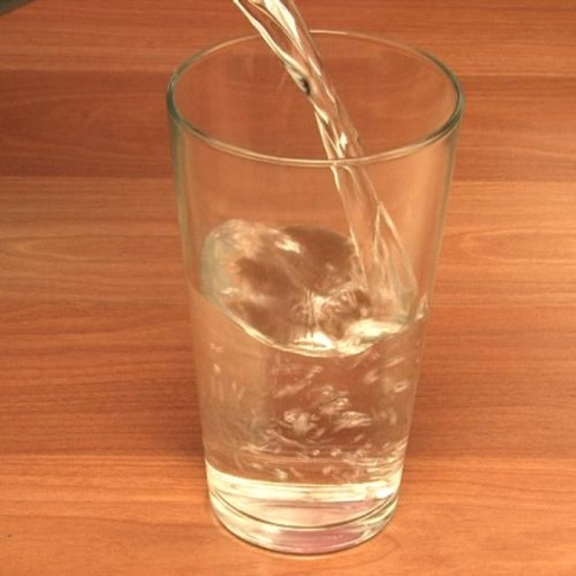
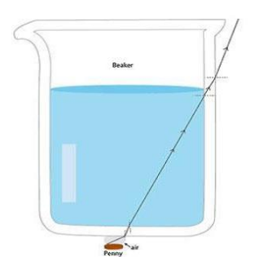
Experiment 2
Why does it work?
Because of the huge difference between the index of refraction of air and pyrex (glass)
Light bends giving very sharp turns. This bending also occurs away from the eye of the viewer
Sharp turns

Slide 11
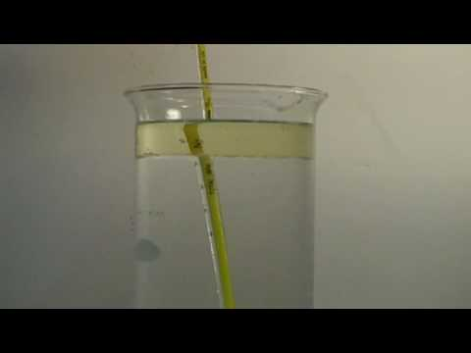
Experiment 3
Why does it work?
This happens due to the refraction of light.
Air, water and oil have different index of refraction which makes the light bend

Slide 12
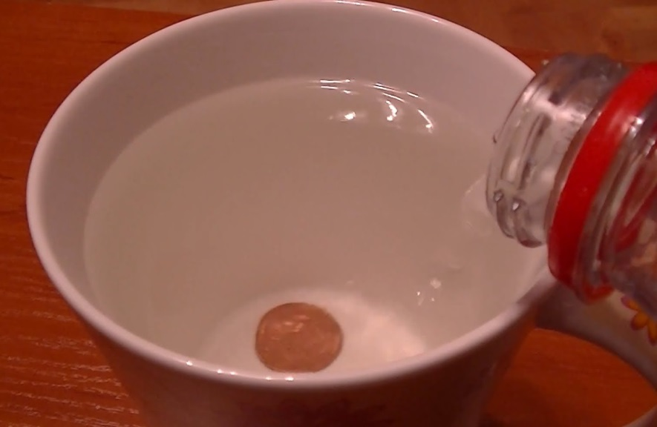
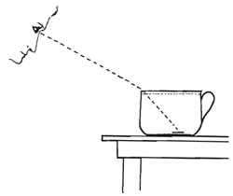
Experiment 4
Why does it work?
Refraction of light

Slide 13
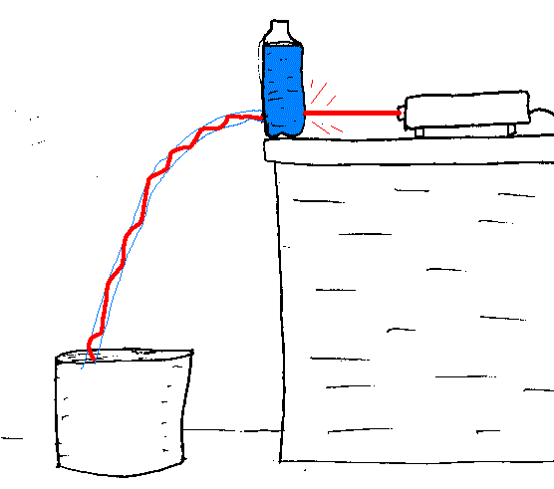
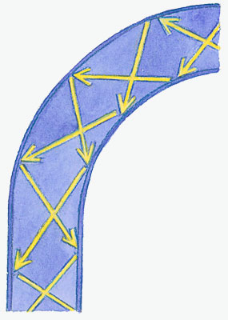
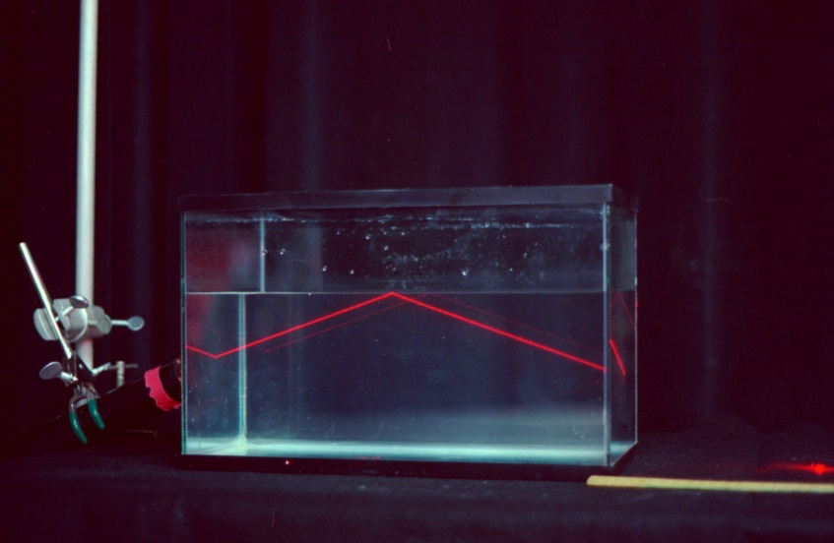
Experiment 5
Why does it work?
Due to total internal reflection

Slide 14
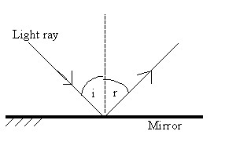
Experiment 6
Why/how does it work?
This happens due to reflection.
Angle of incidence=angle of reflection
Some surfaces reflect light better than others

Slide 15
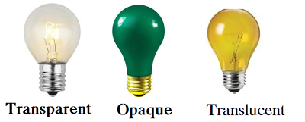
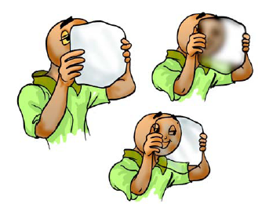
Experiment 7
Transparent
Most light goes through the object
Translucent
Some light goes through the object
Opaque
Light does not go through the object. This produces shadows

Slide 16
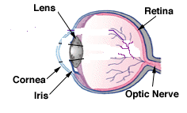
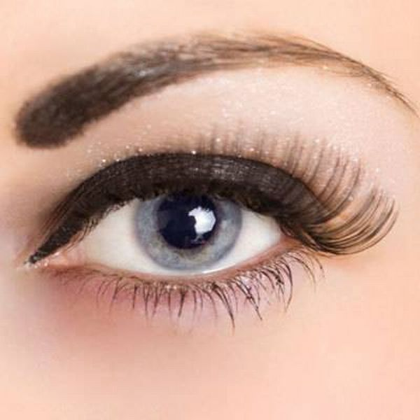
The lenses in our eyes
a. Lens: Convex-shaped. Focuses light
b. Cornea: transparent front part of the eye that covers the iris and pupil
c. Iris: controls the diameter and size of the pupil
d. Pupil: controlls how much light enertes the eye
e. Retina: its purpose is to receive light focused from the lens, convert the light into neural signals, and send these signals to the brain
f. Optic nerve: sends information from the retina to the vision center of the brain via electrical impulses
Iris
Pupil

Slide 17
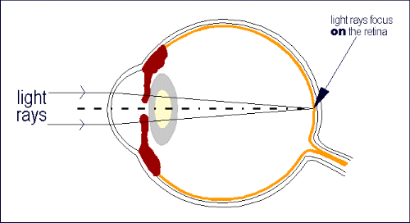
How do we focus light?
Light is focused on the retina

Slide 18
Why do some people need to wear glasses?
Near sightedness:
The eye is elongated so the light rays are focused in front of the retina
Far sightedness:
The eye is compressed so the light rays are focused behind the retina

Slide 19
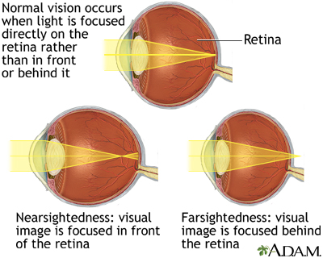
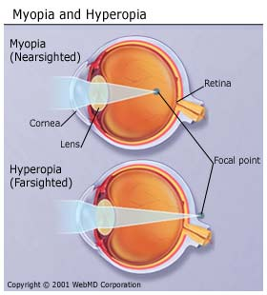

Slide 20
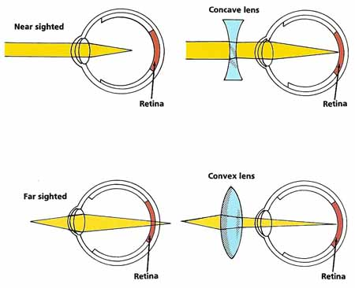
Glasses- correcting near and far-sightedness
Near sighted: concave lenses
Far sighted: convex lenses

Slide 21
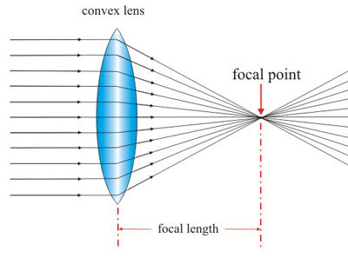
Convex lenses
They flip images upside down

Slide 22
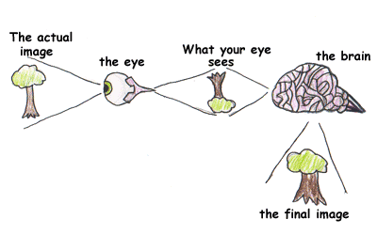
Do we see everything upside-down?
Even though the lenses from our eyes flip images, our brain makes sense of what we see and flips them back so we do not see things upside down

