Slide 1
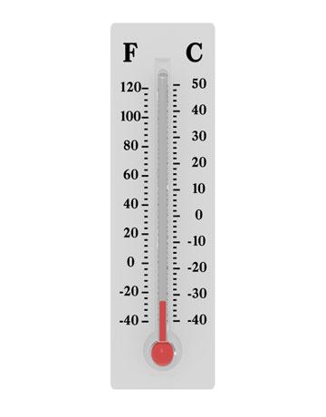

Slide 2
Thermometer/Termometro

Slide 3
Used to measure temperature

Slide 4
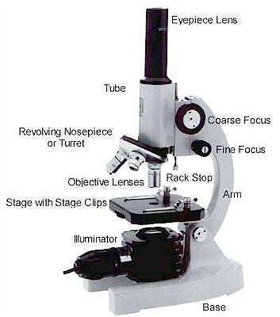

Slide 5
Microscope/Microscopio

Slide 6
Used to make very small objects look larger

Slide 7
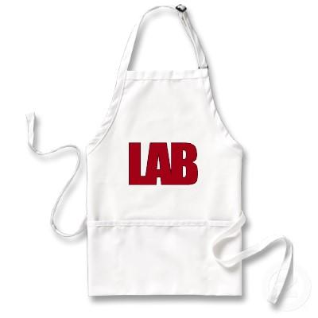
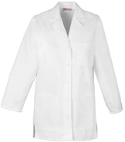

Slide 8
Laboratory Coat/Bata de laboratorio

Slide 9
Used to protect your clothes

Slide 10
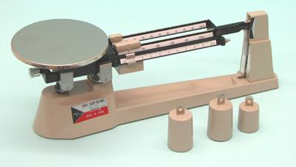

Slide 11
Triple beam balance/Balanza de tres brazos

Slide 12
Used to find the mass of an object

Slide 13
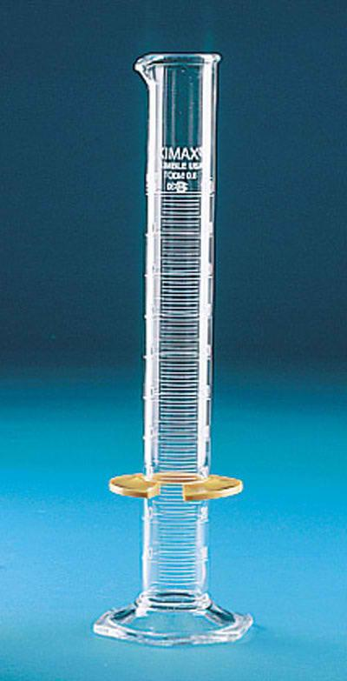
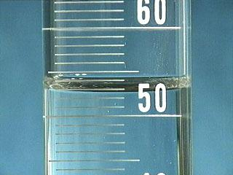

Slide 14
Graduated cylinder/Probeta

Slide 15
Used to measure the volume of a liquid (or how much space the liquid takes up).
Read the bottom of the curve, or meniscus, to find the accurate mL

Slide 16
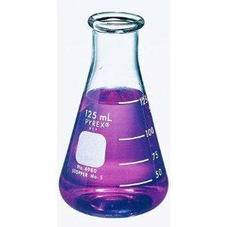

Slide 17
Erlenmeyer flask/Matraz de Erlenmeyer

Slide 18
Used to hold, mix, pour, and heat up liquids

Slide 19
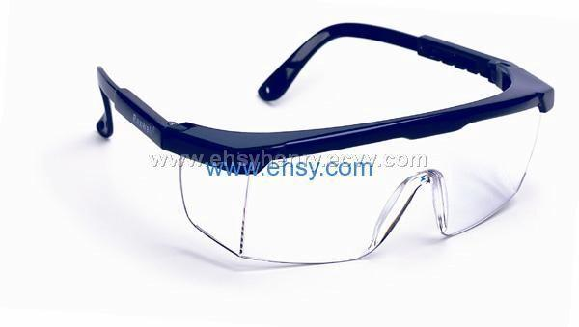

Slide 20
Safety goggles/Gafas protectoras

Slide 21
Used to protect your eyes

Slide 22
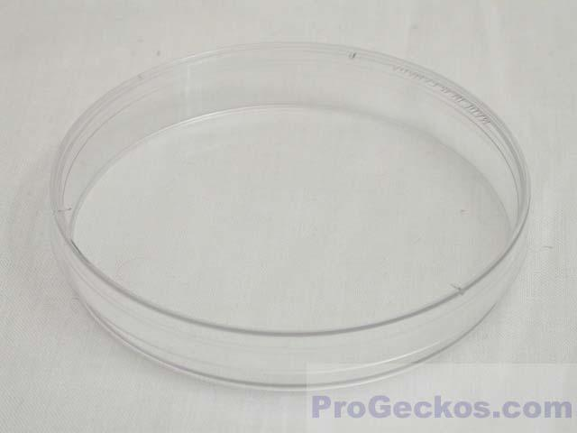

Slide 23
Petri dish/Placas de petri

Slide 24
Used to grow microorganisms

Slide 25
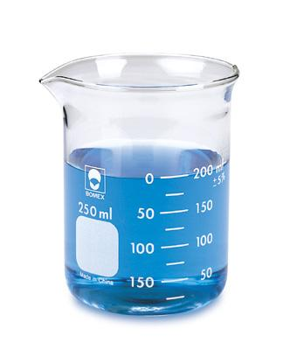

Slide 26
Beaker/Vaso de precipitado

Slide 27
Used to hold, mix, and heat liquids.
Also used to pour liquids into other containers

Slide 28
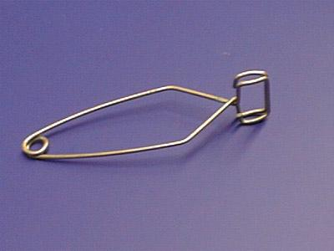

Slide 29
Test tube holder/Pinzas para tubo de ensayo

Slide 30
Holds a test tube while being transported

Slide 31
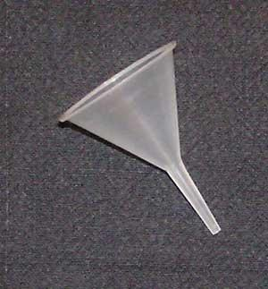

Slide 32
Funnel/embudo

Slide 33
Used to separate solid particles from a liquid by placing filter paper in it

Slide 35
Ring Stand/Soporte Universal

Slide 36
The iron ring is attached to this object in order to hold test tubes and beakers

Slide 37
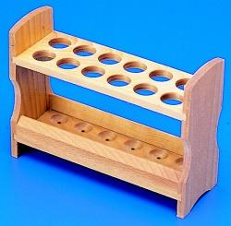

Slide 38
Test tube rack/Gradilla

Slide 39
Used to store/hold many test tubes at once

Slide 40
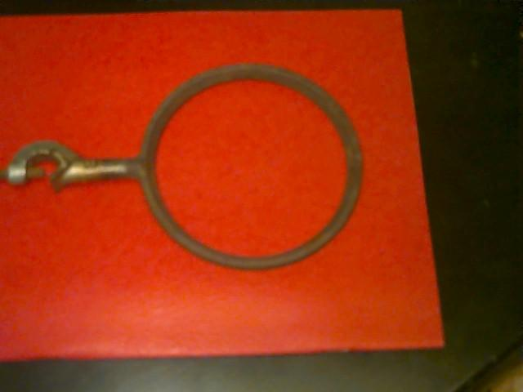

Slide 41
Iron Ring/Anillo de hierro

Slide 42
Used to hold beakers that are being heated under a direct flame

Slide 43
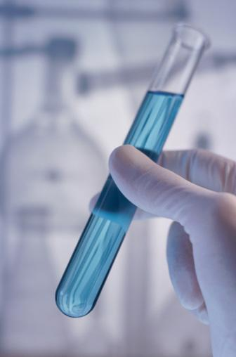

Slide 44
Test tube/tubo de ensayo

Slide 45
Used to hold a small amount of a liquid or solid

Slide 46
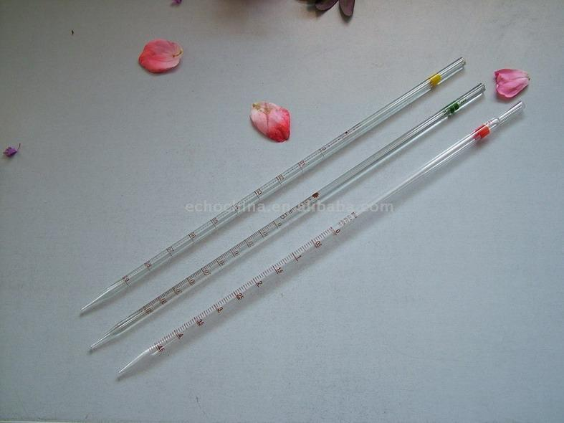
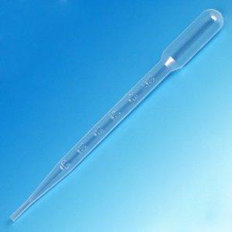

Slide 47
Pipette/Pipeta

Slide 48
Used to measure very small amounts of liquids (drops)

Slide 49
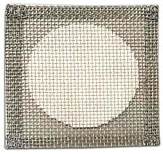

Slide 50
Wire gauze/Malla de asbesto

Slide 51
Used to spread heat evenly over a container and avoids direct contact between the glass and a flame

Slide 53
Test tube clamp/Pinzas para sujetar tubos de ensayo al soporte universal

Slide 54
Used when clamping the test tube to a ring stand

Slide 55
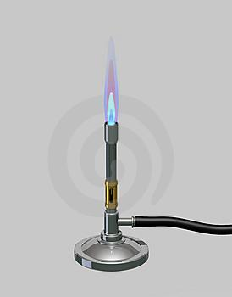

Slide 56
Bunsen burner/Mechero de Bunsen

Slide 57
Used to heat up substance

Slide 58
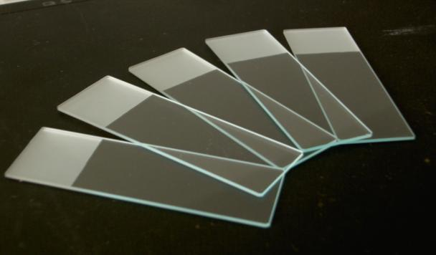

Slide 59
Microscope slide/Portaobjetos

Slide 60
Used to hold objects for examination under a microscope

Slide 61
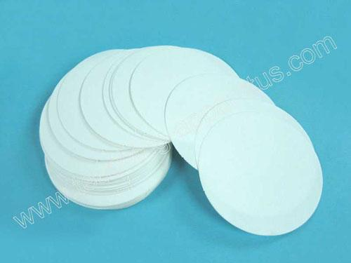

Slide 62
Filter paper/Papel filtro

Slide 63
Paper used to separate solid particles from a liquid by placing it in a funnel

Slide 64
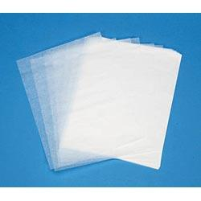

Slide 65
Lens paper/Papel para limpiar lentes

Slide 66
Paper used to clean the lenses in a microsope

Slide 67
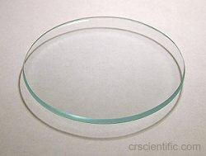

Slide 68
Watch glass/Vidrio de reloj

Slide 69
Used to hold dry ingredients

Slide 70
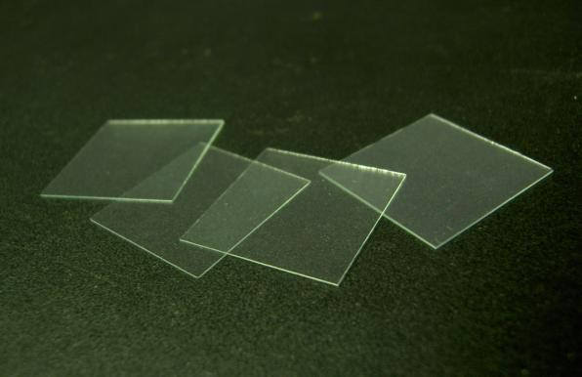

Slide 71
Cover slip/Cubreobjetos

Slide 72
Transparent material that is placed over objects for viewing with a microscope

Slide 73
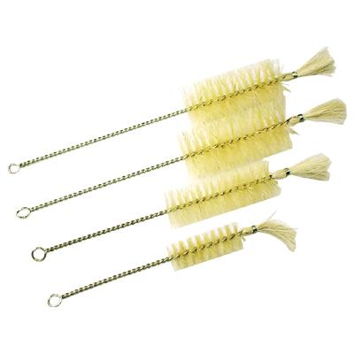
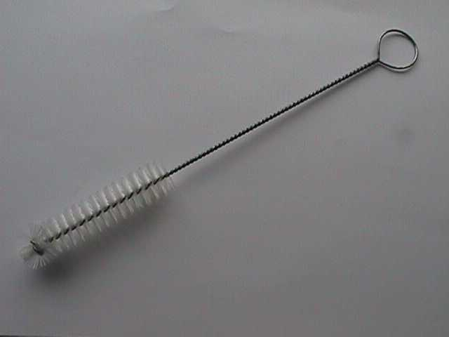

Slide 74
Test tube brush/Escobillon

Slide 75
Used to wash test tubes

