Slide 1
Meiosis

Slide 2
Vocabulary
Somatic cells- Any cell, other than a gamete, forming the body of an organism
Gametes- sex cells (eggs and sperm)
Homologous chromosomes: Chromosomes that have a corresponding chromosome from the opposite-sex parent (2 sets of chromosomes, one from each parent)
Diploid (2n)- A cell that contains both sets of homologous chromosomes.
Haploid (n)- A cell that contains only a single set of chromosomes

Slide 3
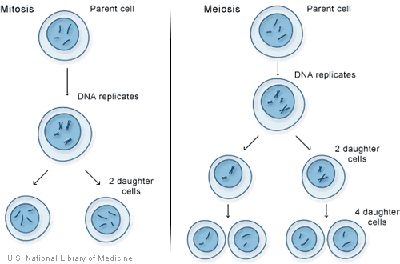
Mitosis vs Meiosis
Mitosis:
Two identical cells
Meiosis:
4 cells that are
genetically different

Slide 4
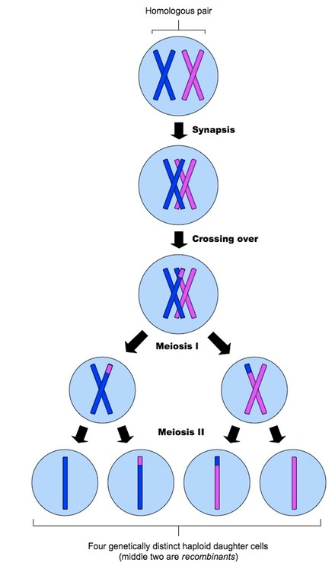
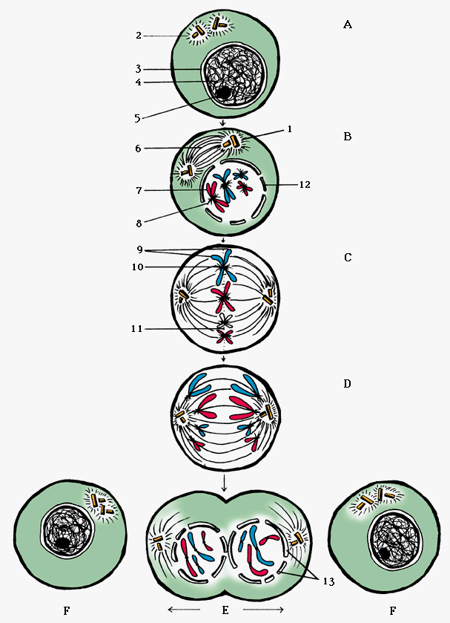
Mitosis Meiosis

Slide 5
Interphase
DNA is uncoiled (called chromatin)
DNA replicates
Cell grows
><
<

Slide 6
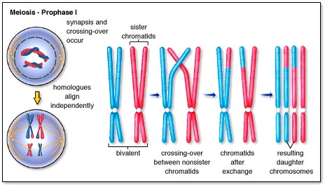
Prophase I
DNA condenses (called chromosome)
Nucleus disintegrates
Homologous chromosomes pair up (forming a tetrad)
Crossover occurs between tetrads

Slide 7
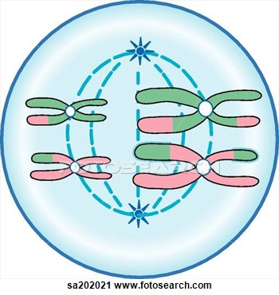
Metaphase I
Tetrads line up in the middle of the cell

Slide 8
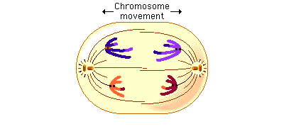
Anaphase I
Homologous chromosomes split up and move toward opposite ends of the cell

Slide 9
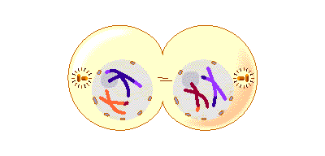
Telophase I
2 independent cells begin to form
Nucleus forms on each cell
DNA uncoils

Slide 10
Cytokinesis
Occurs at the same time as telophase
Division of the cytoplasm to make 2 haploid cells

Slide 11
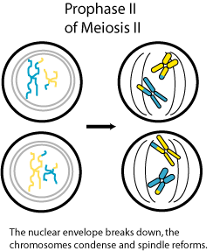
Prophase II
Chromosomes do not pair up
Nucleus disappears
DNA condenses

Slide 12
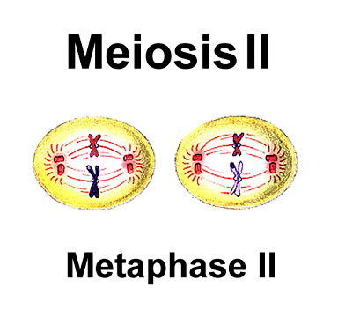
Metaphase II
Chromosomes line up in the middle of the cell

Slide 13
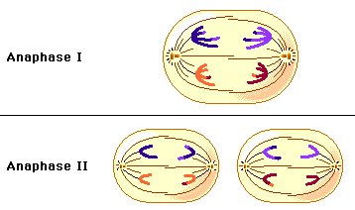
Anaphase II
Sister chromatids split up

Slide 14
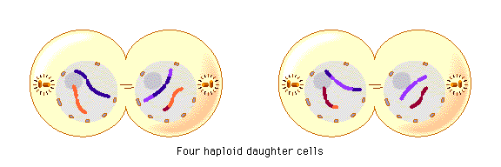
Telophase II
4 haploid daughter cells (gametes) are being formed
Each gamete makes a nucleus
Chromosomes uncoil (forming chromatin)

Slide 15
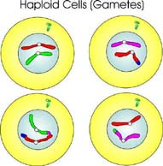
Cytokinesis
Occurs at the same time as telophase II
4 different cells are formed

Slide 16
Meiosis diagram
XX
X
X
Meiosis I
>
<
>
<
Meiosis II

Slide 17
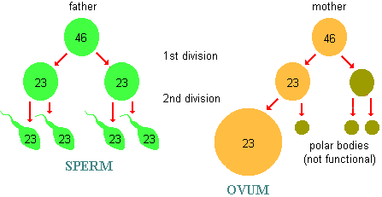
Sex cells- men vs women
Men: produce four sperms
Women: produce one egg. The rest become “polar bodies”

