Slide 1
Work and Energy

Slide 2
What is energy? What is work?
Energy is the ability to do work
Work is the energy transfered by force (using a force to move an object)

Slide 3
Two types of energy
Potential
Kinetic

Slide 4
Potential energy
Stored energy
Potential to do work

Slide 5
Kinetic energy
Energy of motion
It can be the motion of waves, electrons, atoms, molecules, substances and objects

Slide 6
4 types of potential energy
Chemical energy
Mechanical energy
Nuclear energy
Gravitational energy

Slide 7
5 types of kinetic energy
Radiant energy
Thermal energy
Mechanical energy
Sound
Electrical energy

Slide 8
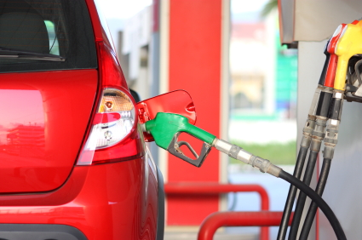
Chemical energy
Chemical energy is energy stored in the bonds of atoms and molecules. Batteries, biomass, petroleum, natural gas, and coal are examples of stored chemical energy. Chemical energy is converted to thermal energy when we burn wood in a fireplace or burn gasoline in a car's engine.

Slide 9
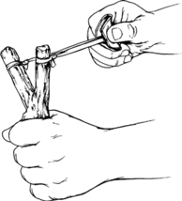
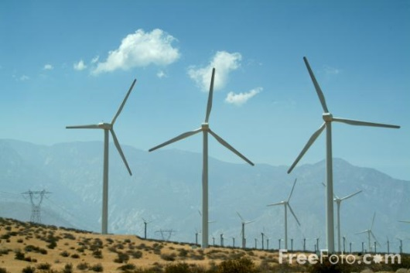
Mechanical energy
Can be potential or kinetic energy
Potential Mechanical energy is energy stored in objects by tension. Compressed springs and stretched rubber bands are examples of stored mechanical energy.
Kinetic Mechanical energy is energy in the movement of objects. Wind is an example of motion energy.

Slide 10
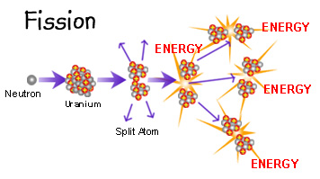
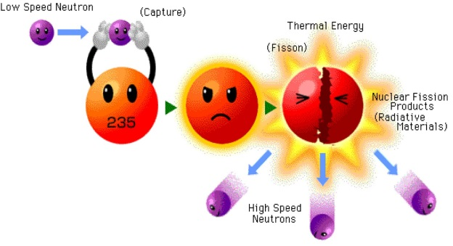
Nuclear energy
Nuclear energy is energy stored in the nucleus of an atom — the energy that holds the nucleus together. Very large amounts of energy can be released when the nuclei are combined or split apart. Nuclear power plants split the nuclei of uranium atoms in a process called fission. The sun combines the nuclei of hydrogen atoms in a process called fusion.

Slide 11
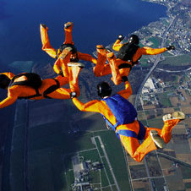
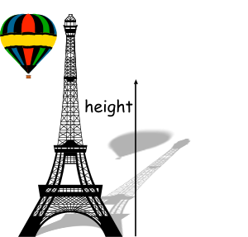
Gravitational energy
Gravitational energy is energy stored in an object's height. The higher and heavier the object, the more gravitational energy is stored. When you ride a bicycle down a steep hill and pick up speed, the gravitational energy is being converted to motion energy.

Slide 12
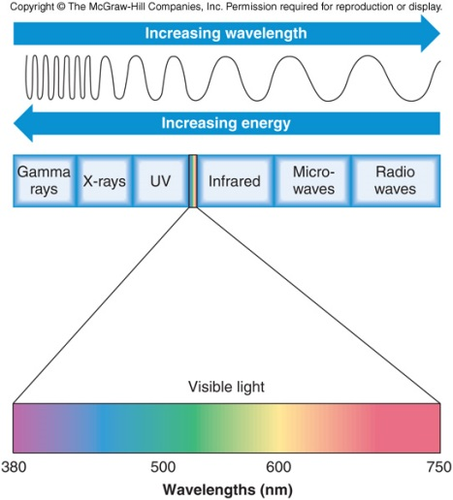
Radiant energy
Radiant energy is electromagnetic energy that travels in transverse waves. Radiant energy includes visible light, x-rays, gamma rays and radio waves. Light is one type of radiant energy. Sunshine is radiant energy, which provides the fuel and warmth that make life on Earth possible

Slide 13
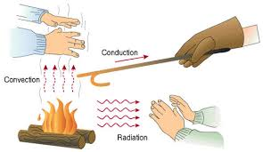
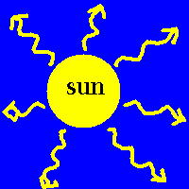
Thermal energy
Thermal energy, or heat, is the vibration and movement of the atoms and molecules within substances. As an object is heated up, its atoms and molecules move and collide faster. Geothermal energy is the thermal energy in the Earth

Slide 14
Sound
Sound is the movement of energy through substances in longitudinal (compression/rarefaction) waves. Sound is produced when a force causes an object or substance to vibrate — the energy is transferred through the substance in a wave. Typically, the energy in sound is far less than other forms of energy.

Slide 15
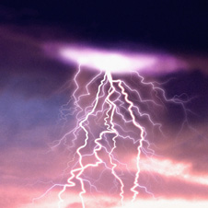
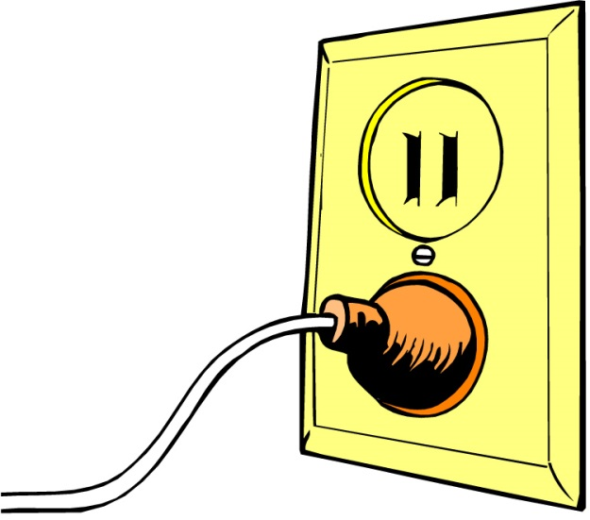
Electrical energy
Electrical energy is delivered by tiny charged particles called electrons, typically moving through a wire. Lightning is an example of electrical energy in nature, so powerful that it is not confined to a wire

Slide 16
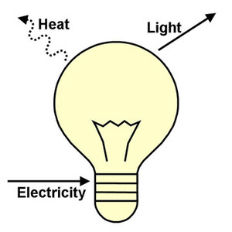
Laws of energy
Conservation of energy
Energy is neither creted nor destroyed. When we use energy, it doesn´t disappear; we change it from one form of energy to another

Slide 17
Examples
1- Electrical energy from toaster → heat energy
2- Radiant energy from the sun → electrical energy
3- Chemical energy from the food we eat → mechanical energy (running or walking)

